Slide 1
OOPS Project: Bus Reservation System
Submitted By:- Submitted To:-
Akul Gaind - CO19306 Dr. Sarabjeet Singh
Darshan Saraswat - CO19320
Tushar Rana - CO19369

Slide 2
Project Aim
And
Working
We have created a bus reservation system in which we can store the data of buses and reserve tickets and then also fetch them accordingly.
Install Bus: makes you add bus details.
Reservation of bus seats: reserving bus tickets for the passengers.
Show Ticket availability: Shows ticket availability and the tickets reserved.
Buses Available: Displays the number of buses available.
Exit: ends the program.
The names suggest what the functions would do.

Slide 3
What We Used
Switch Case
Switch case statement is used when we have multiple conditions and we need to perform different actions based on the condition.
Syntax
switch (n)
{
case 1: // code to be executed if n = 1;
break;
case 2: // code to be executed if n = 2;
break;
default: // code to be executed if n doesn't match any cases
}

Slide 4
What We Used
Conditional Statements
If Else Statement:- It is used to execute some statement code block if the expression is evaluated to true, otherwise executes else statement code block.
Syntax
if(condition){
//Statements inside of if block
}
else{
//Statements inside of else block
}

Slide 5
What We Used
Loops
While loop
Do-while loop
For loop
Range based Loop:- It is a new feature of C++ which was added in C++ 11. It is only worked in CodeBlocks and Visual Studio Code.
Encapsulation
Binding data members and member functions in one unit known as a class. With the help of this concept, data is not accessible to the outside world and only those functions which are declared in class can access it.

Slide 6
What We Used
Class and Objects
A class in C++ is a user defined data type or data structure. In simple words, a class ia a collection of objects of similar type. It is a instance of class. When a class is defined, no memory is allocated when object is instantiated memory is allocated.
Syntax
class ClassName
{ Access specifier;
Data Member;
Member Functions;
};
ClassName ObjectName;

Slide 7
What We Used
Inheritance
Inheritance is a process by which objects of new class acquire the properties of objects of existing class. Using inheritance, we can increase a class functionalities.
Syntax
class subclass_name : access_mode base_class_name
{
//body of subclass
};

Slide 8
What We Used
Functions Like
fflush(stdin) is used to clear the buffer.
vline():- It draw a vertical line using ch starting at the cursor position in the window.
Other functions
Data Hiding:- Using access specifiers like public, private and protected we can choose which members can be accessed by outside sources and which members cannot.
STL:- We used classes defined in Standard Template Library like “string” classes.

Slide 9
Results

Slide 10
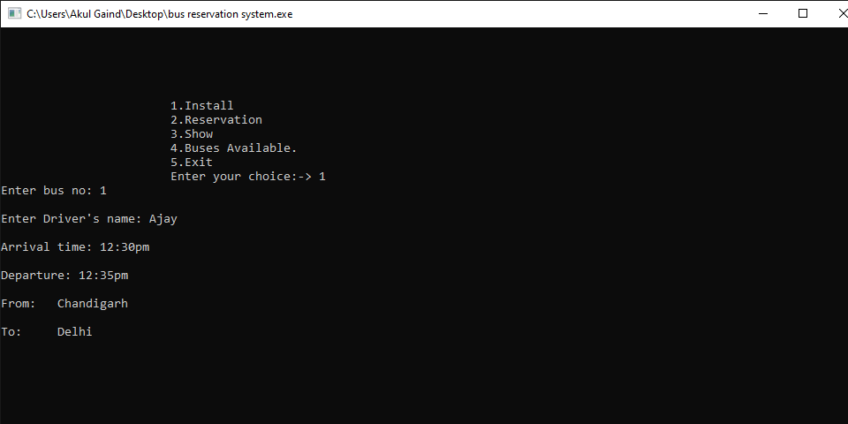
Installing a Bus Information

Slide 11
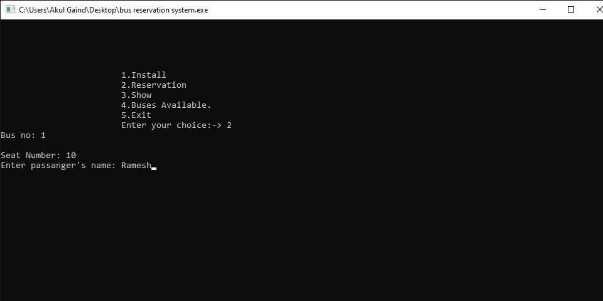
Reserving ticket for a Passenger

Slide 12
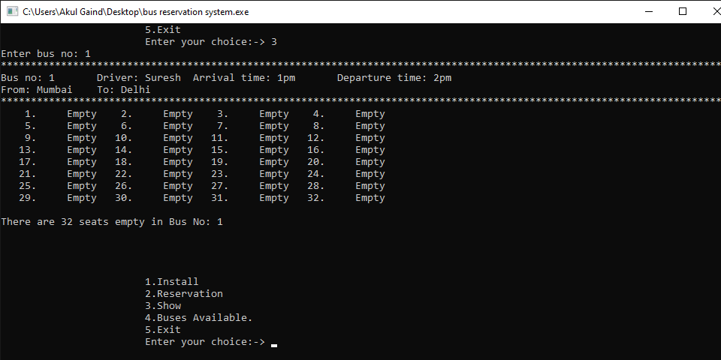
Checking Seats Reserved/Availability

Slide 13
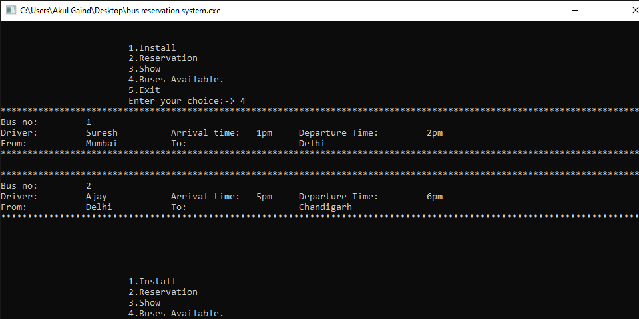
Showing Buses Available

